Slide 1
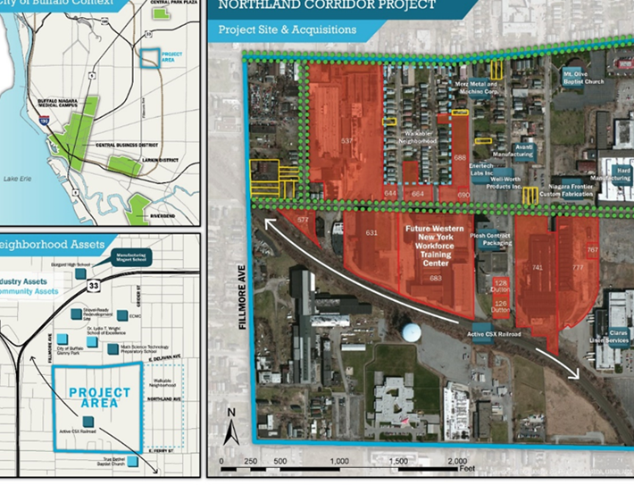
Request for Proposals Food Service Operator at Northland Beltline Corridor
A Growing, Underserved Market with Transformative Potential

Slide 2
Welcome to Northland Central: A Unique Opportunity
Overview: Northland Central is part of the transformative Northland Beltline Corridor Redevelopment on Buffalo’s East Side – a hub for community innovation, diversity, and economic growth.
Redevelopment Highlights:
Phase 1: Creation of the Northland Workforce Training Center (NWTC) and repurposing of 120,000 sq. ft. into cutting edge training facilities, classrooms, and tenant space
Phase 2: Streetscape enhancements, including new signage, traffic signals, granite curbs, curb extensions, wider sidewalks, tree planting, and a vibrant public space.
Phase 3: Development of light industrial and advance manufacturing spaces at 541 E. Delavan and 612 Northland “B”
Phase 4: Renovation of 631 Northland, a 40,000 sq. ft. historic building listed on the National Register of Historic Places.

Slide 3
State-of-the Art Facilities
A Premier Space for Culinary Excellence: Highlight the 3,647 sq. ft. café space at Northland Central, designed to accommodate diverse dining needs.
Modern Amenities:
Fully-equipped kitchen with advanced appliances
Spacious dining area offering comfort and flexibility
Seasonal outdoor patio for dining and events
Strategic Location:
Adjacent to NWTC training labs and community spaces
Shared public access on the ground floor for students, staff, the East Side community, and Northland tenants (Bank on Buffalo, Retech Systems, BMW, Rodriguez Construction, Rookery, and Flat 12 Mushrooms
Versatile Setup: The design supports full-service dining, casual “grab-and-go” options, and catering services

Slide 4
A Growing, Underserved Market
Diverse Audience:
Reach 350-400 students and 50 staff at NWTC
Serve 455 workers employed at nearby businesses
Engage 2,337 residents in the immediate area
Community Impact:
Address a trade area underserved by food options
Establish the café as a hub for a quality dining and social interaction

Slide 5
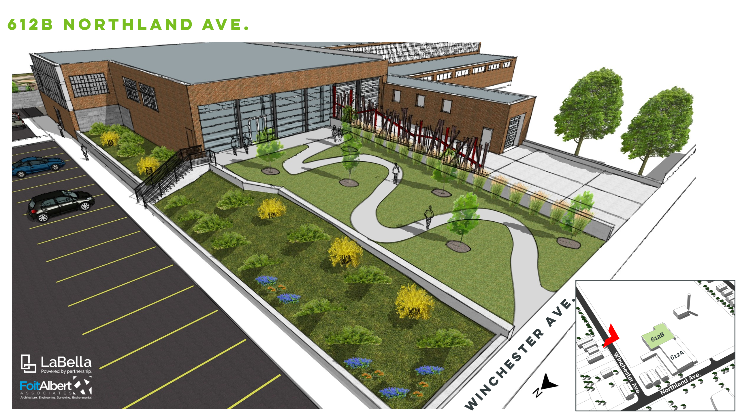
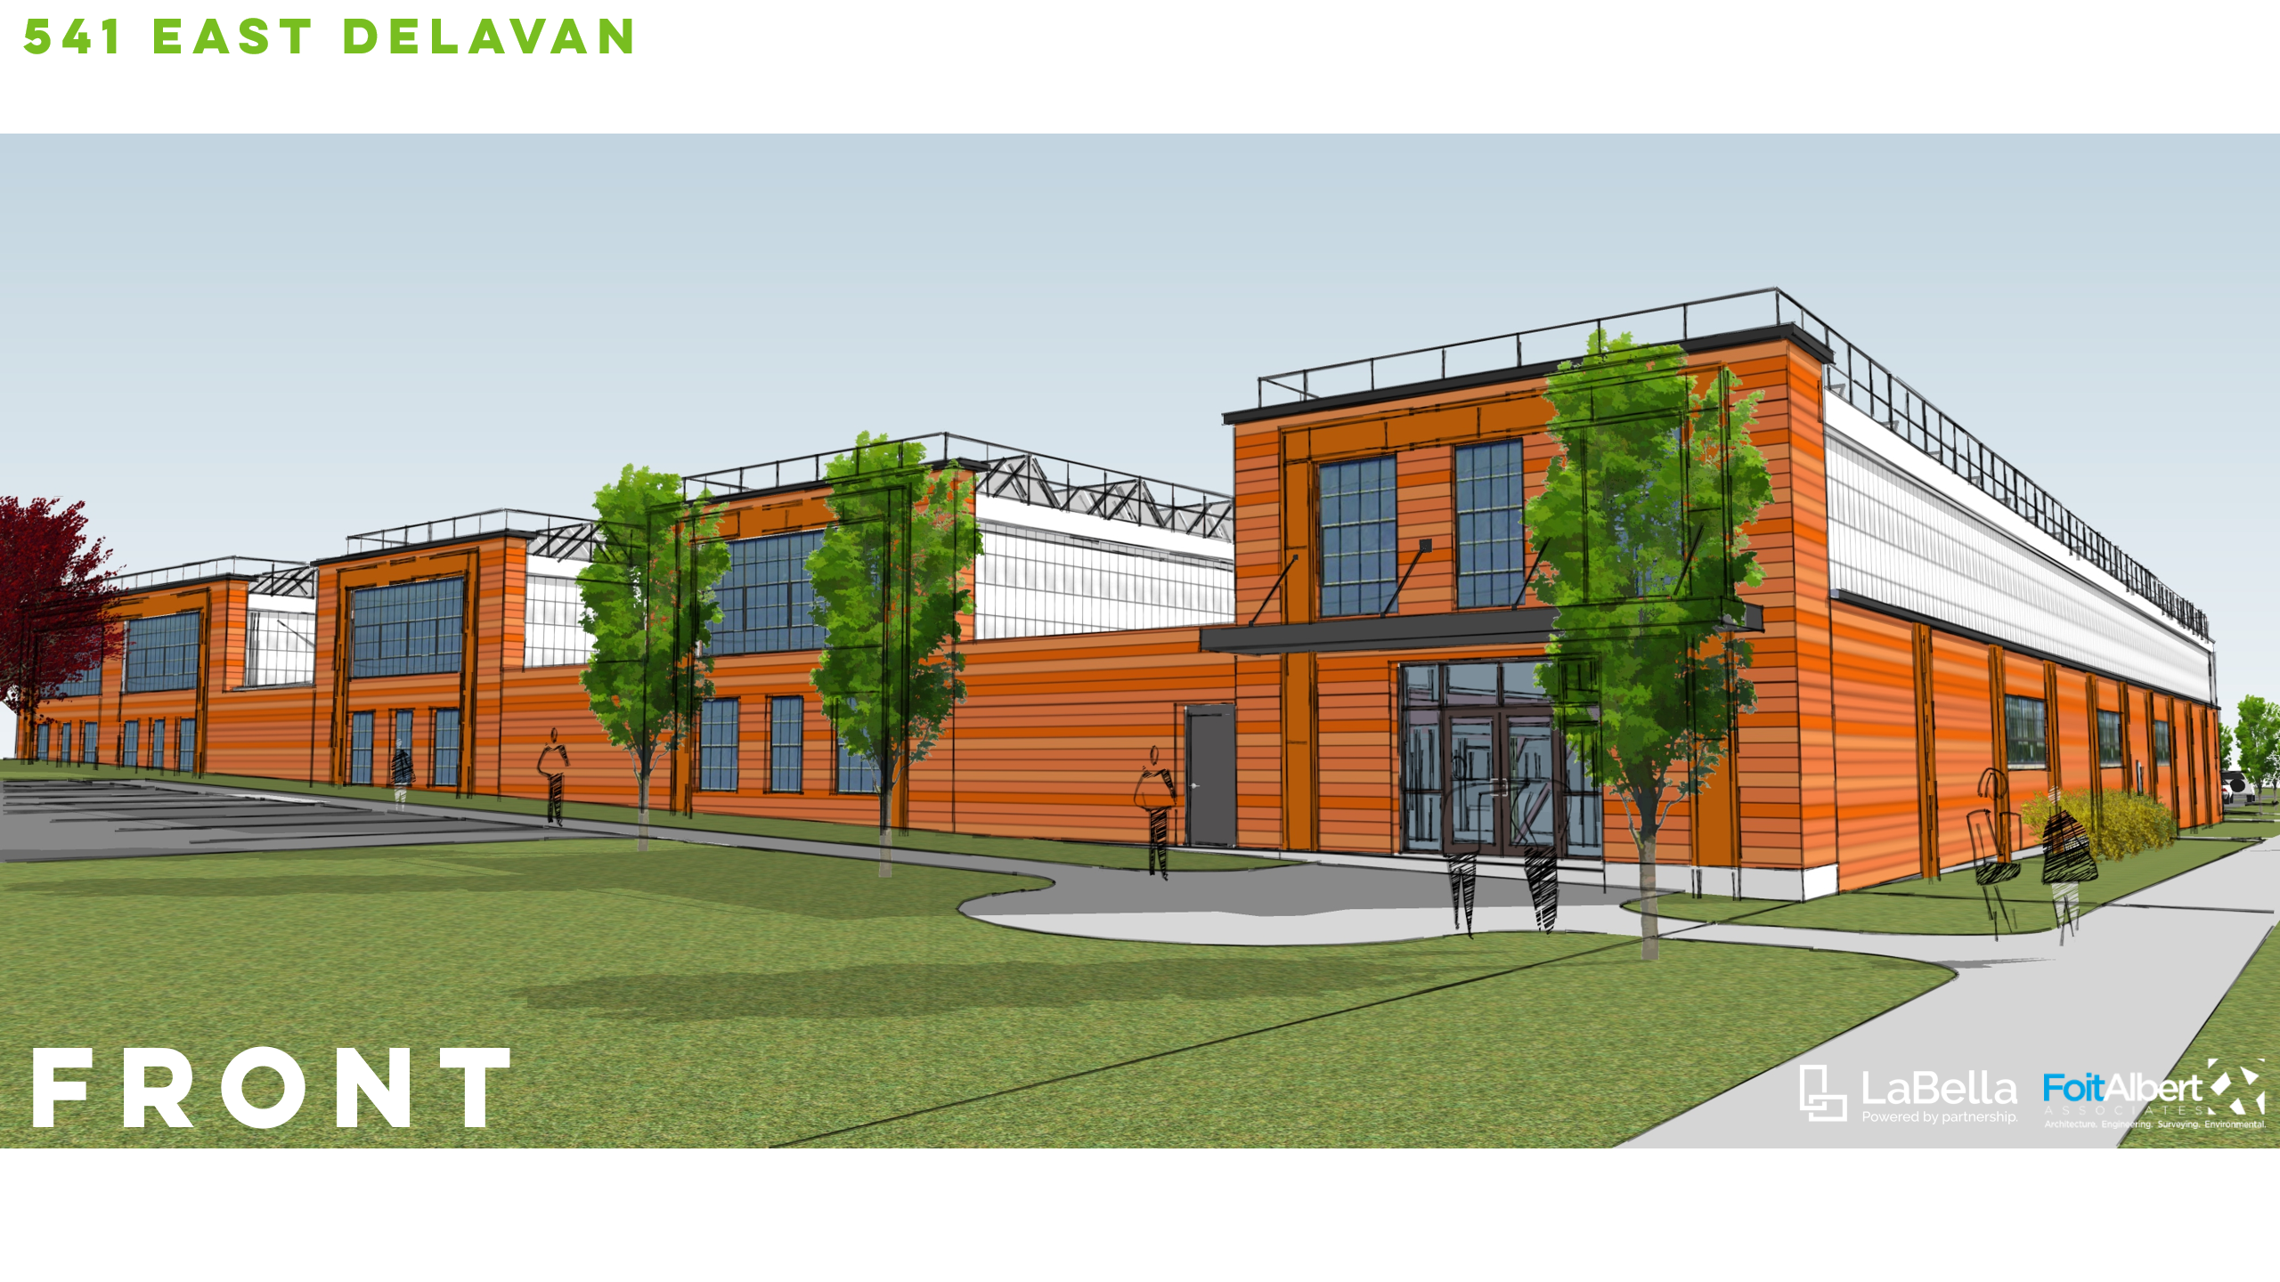
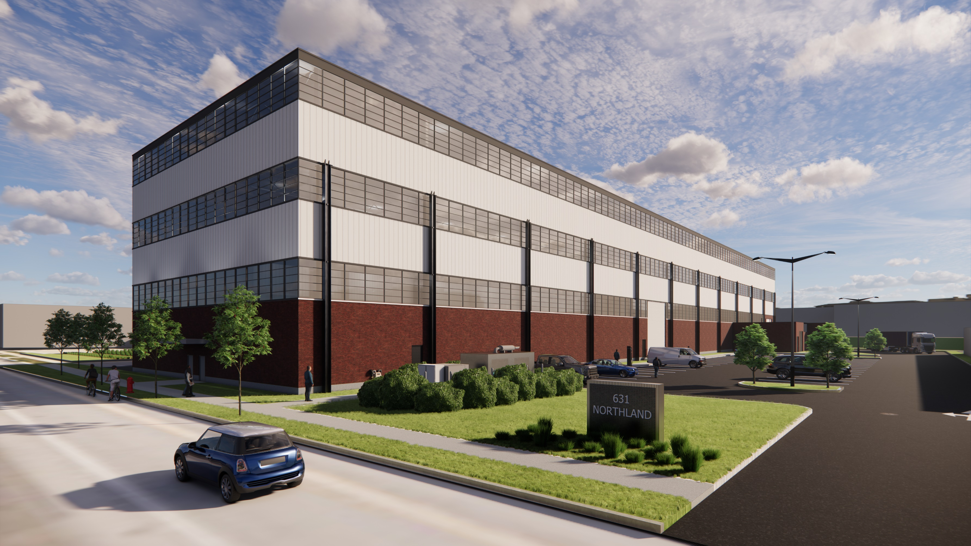
A Growing, Underserved Market
631 Northland

Slide 6
Operator Benefits: Your Role in Revitalization
Community Impact:
Join transformative initiative that supports workforce development, diversity, and innovation in Buffalo’s East Side
Become a key partner in enhancing the quality of life for students, faculty, staff, tenants, and the surrounding neighborhood
Collaborative Opportunities:
Work alongside BUDC and NWTC on catered events and programming
Flexible operational terms, such as breakfast/lunch-only service or shared vendor space
Supportive Ecosystem:
Access resources like the Beverly Gray Business Exchange and Small Business Development Center to strengthen your operations
Key Objectives:
Deliver quality, nutritious, and affordable food options
Align operations with NWTC’s hours for maximum synergy with on-site programs and events
Develop innovative food solutions catering to the unique needs of the East Side community

Slide 7
Next Steps: Your Journey Begins Here
Review & Proposals Submission
  Review the RFP, including operational requirements, terms, and evaluation
  Prepare and submit a proposal that highlights your experience, vision, and alignment with Northland Central’s goals
Key Deadlines
  Questions Submission: April 28, 2025, 4:00 PM
  Proposal Submission: May 12, 2025, 4:00 PM
Contact Information
  Email: arhodes@buffalourbandevelopment.com
  (716) 362-8384

Slide 8
Questions

